Slide 1
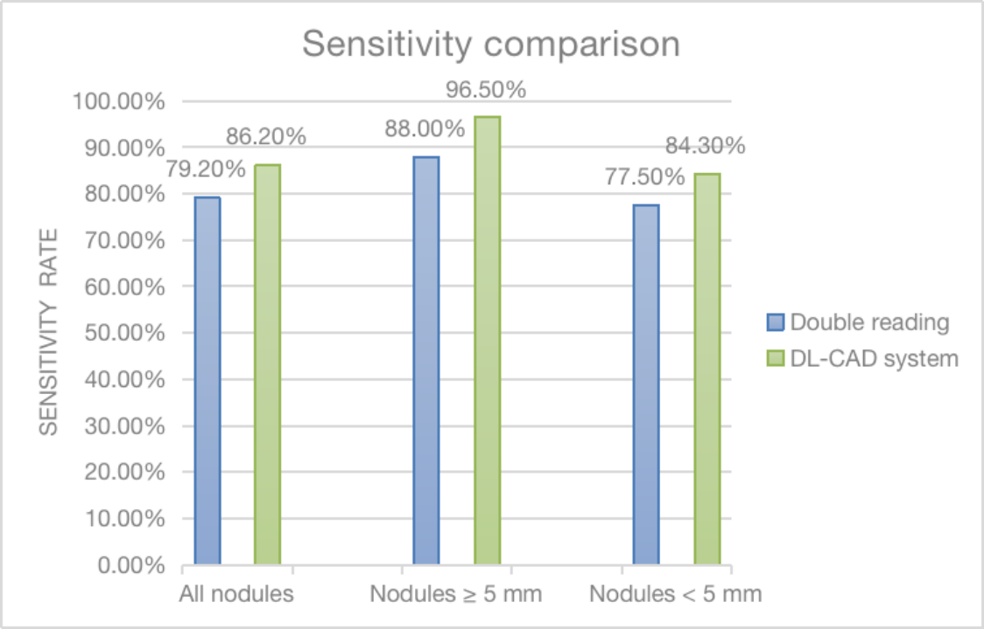
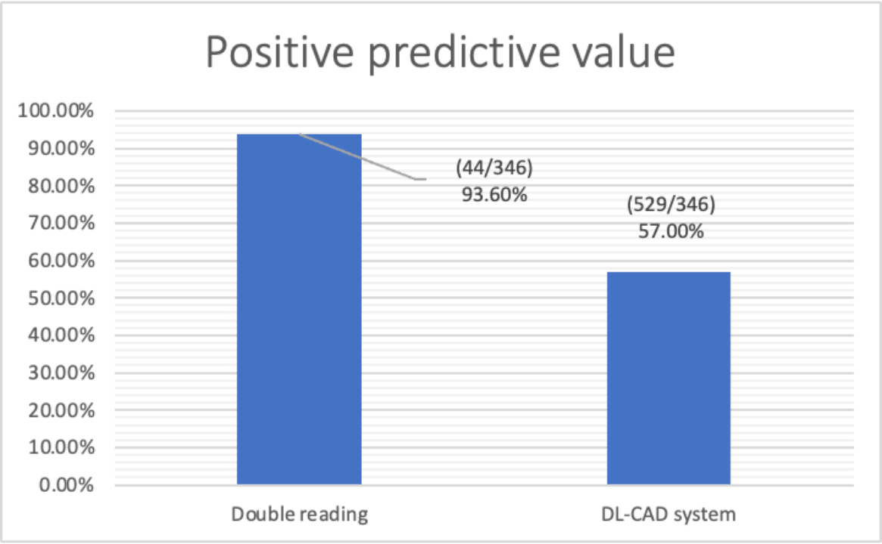

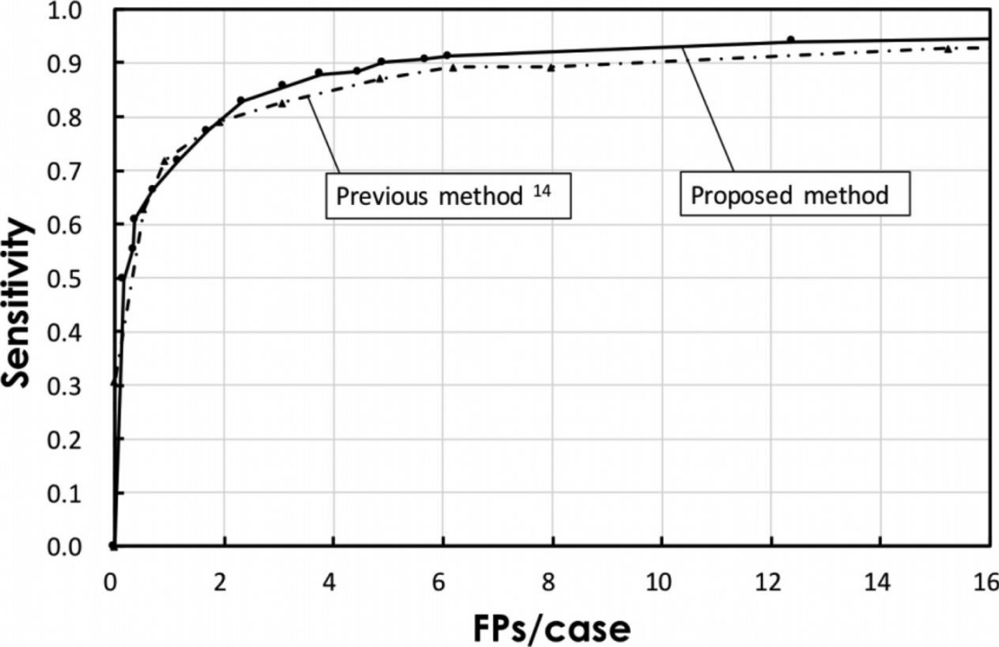



Improving the Positive Predictive Rate in Pulmonary Nodule Detection with Computer-Aided Diagnosis
Name: Fangxu Wu P-Number: P333077
Introduction
Background: Cancer is one of the most prevalent and deadly diseases in the world, and lung cancer is the most common and deadly among them. Medical imaging is the commonly used method in the diagnosis of lung cancer, however, the initial symptoms of lung cancer are often not obvious, which makes lung cancer Usually not well detected at an early stage. Computer-aided diagnosis (CAD) is a method that uses computers to analyze medical images and assist doctors in diagnosis. The main advantages of this method are its high efficiency and accuracy.
Research question:
1 What is the impact of computer-aided diagnosis (CAD) on the accuracy of lung cancer diagnosis?
2 How can the accuracy of computer-aided diagnosis (CAD) for lung cancer diagnosis be improved?
Figure 1-1 Sensitivity comparison(Li et al., 2019)
Figure 1-2 Positive predictive value(Li et al., 2019)
Figure 2-1：FROC curves of the proposed and previous methods.(Teramoto et al., 2016)
Research 2 Figure 2-2 introduces the Free Response Receiver Operating Characteristic (FROC) curve as a criterion for judging the accuracy of CAD detection, and the research indicates that the convolutional neural network technique shows better accuracy and sensitivity than previous methods Discussion The article proposes that convolutional network neural technology is prone to the problem of insufficient generalization ability. Future research can try to combine multiple models through ensemble learning to achieve better performance.
Methods
In the choice of research methods, the article mainly chooses the research methods of secondary research and quantitative research. Data is mainly collected through secondary data. The scope of data collection is mainly the school library website and Google Scholar.
During the research process, the method of comparative analysis was mainly used to compare the accuracy of lung cancer diagnosis after traditional radiologists and computer-aided diagnosis. effectiveness of reporting.
Conclusion
This study affirms the positive predictive value of computer-aided diagnosis and proposes that convolutional neural network technology can partially suppress the increase in the probability of false positives. However, the development of convolutional neural network technology requires a large amount of data support, but the current database data samples are limited
1. Improve convolutional neural network technology to avoid overfitting.
2. Increasing case integration and expanding sample size.3. Continue to explore other methods to increase CAD accuracy
Finding and discussion
Research 1
Figure 1-1 The histogram adopts the method of contrast and control variables. Compared with double reading, the computer-aided diagnosis system has higher sensitivity and can detect pulmonary nodules more comprehensively.
Figure 1-2 The results confirm that although the DL-CAD system has better sensitivity for lung cancer detection, its false positive detection probability is much higher than that generated by double-reading.
Discussion
In order to solve these limitations, further research directions are machine learning techniques and the expansion of the database
References
Li, L., Liu, Z., Huang, H., Lin, M. & Luo, D. (2019). Evaluating the performance of a deep learning‐based computer‐aided diagnosis (DL‐CAD) system for detecting and characterizing lung nodules: Comparison with the performance of double reading by radiologists. Thoracic cancer, 10(2), 183-192.
Teramoto, A., Fujita, H., Yamamuro, O. & Tamaki, T. (2016). Automated detection of pulmonary nodules in PET/CT images: Ensemble false-positive reduction using a convolutional neural network technique. Medical physics (Lancaster), 43(6), 2821-2827.

